Slide 1
Bikesh Srivastava ( 8802592478)
Consultant, Speaker, Author & MVP

Slide 2
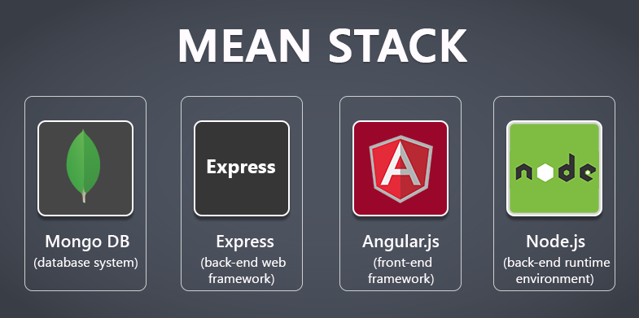
NodeJS and MEAN

Slide 3
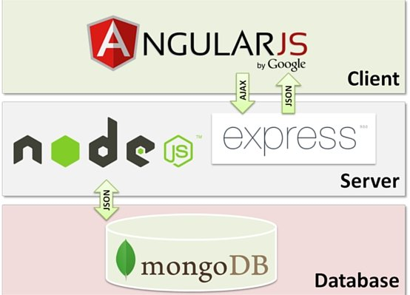
First what is MEAN
M = mongoDB
E = Express
A = Angular (client side)
N=Node.js
FULL stack solution

Slide 4
What is node.js ?
Created 2009
Evented I/O for JavaScript
Server Side JavaScript
Runs on Google's V8 JavaScript Engine

Slide 5
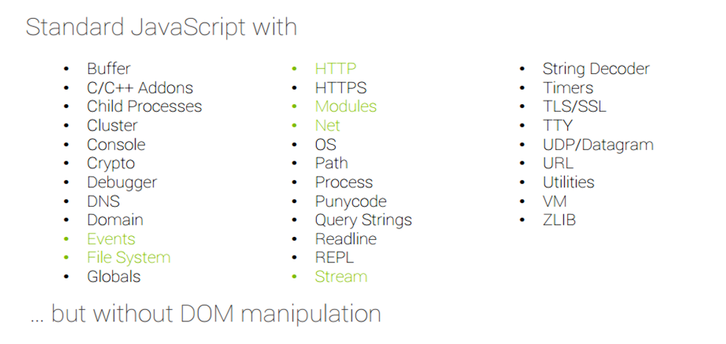
Why Use Node.js ?
Node's goal is to provide an easy way to build scalable network programs.

Slide 6
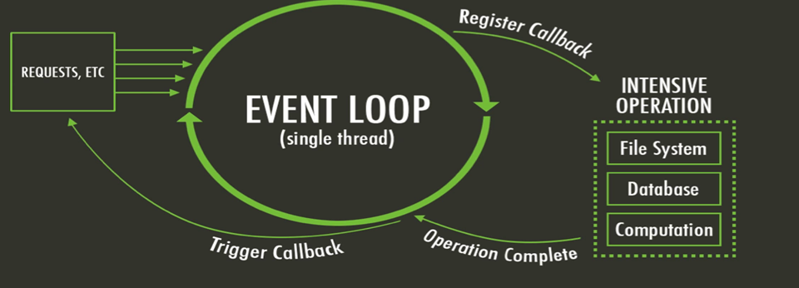
What is unique about Node.js?
JavaScript on server-side thus making communication between client and server will happen in same language
Servers normally thread based but Node.JS is “Event” based. Node.JS serves each request in a Evented loop that can handle simultaneous requests.
Notes:
Thread based servers like Apache server will serve each web request as individual threads which doesn’t fit well for concurrent connections.

Slide 7
What can you do with Node ?
It lets you Layered on top of the TCP library is a HTTP and HTTPS client/server.
The JS executed by the V8 javascript engine (the thing that makes Google Chrome so fast)
Node provides a JavaScript API to access the network and file system.

Slide 8
What can’t do with Node?
Node is a platform for writing JavaScript applications outside web browsers. This is not the JavaScript we are familiar with in web browsers. There is no DOM built into Node, nor any other browser capability.
Node can’t run on GUI, but run on terminal

Slide 9
Threads VS Event-driven
Threads | Asynchronous Event-driven
Lock application / request with listener-workers threads | only one thread, which repeatedly fetches an event
Using incoming-request model | Using queue and then processes it
multithreaded server might block the request which might involve multiple events | manually saves state and then goes on to process the next event
Using context switching | no contention and no context switches
Using multithreading environments where listener and workers threads are used frequently to take an incoming-request lock | Using asynchronous I/O facilities (callbacks, not poll/select or O_NONBLOCK) environments

Slide 10
Why node.js use event-based?
normal process the webserver while processing the request will have to wait for the IO operations and thus blocking the next request to be processed.
Node.JS process each request as events, doesn’t wait (non-blocking) for the IO operation to complete → it can handle other request at the same time.
When the IO operation of first request is completed it will call-back the server to complete the request.

Slide 11
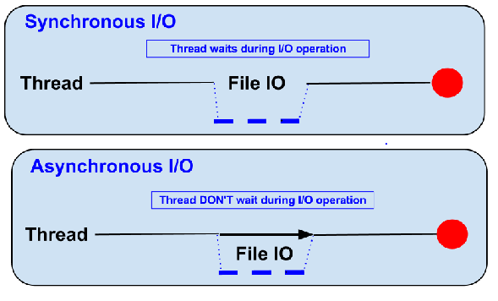

Blocking vs Non-Blocking……
Example :: Read data from file and show data

Slide 12
Blocking…..
● Read data from file
● Show data
● Do other tasks
var data = fs.readFileSync( “test.txt” );
console.log( data );
console.log( “Do other tasks” );

Slide 13
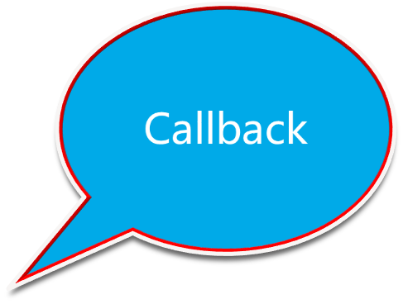
Non-Blocking……
● Read data from file
When read data completed, show data
● Do other tasks
fs.readFile( “test.txt”, function( err, data ) {
console.log(data);
});

Slide 14
Node.js VS Apache
  It's faster
  It can handle tons of concurrent requests
Platform | Number of request per second
PHP ( via Apache) | 3187,27
Static ( via Apache ) | 2966,51
Node.js | 5569,30

Slide 15
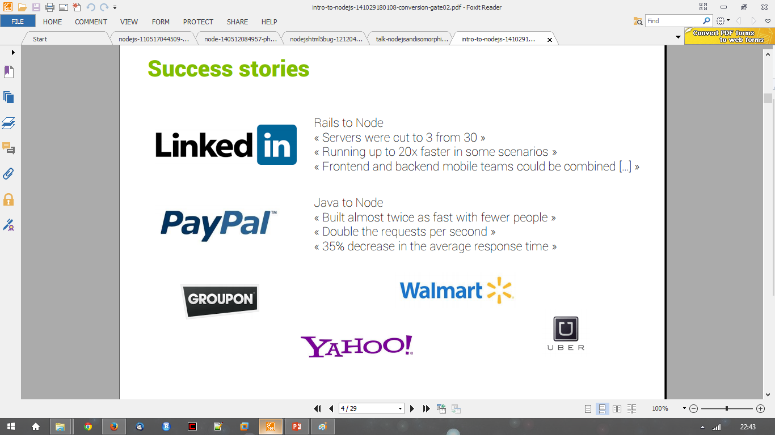
Success Stories…..

Slide 16
Supports HTTP Method……
● GET
● POST
● PUT
● DELETE

Slide 17
When to use it ?
• Chat/Messaging
• Real-time Applications
• Intelligent Proxies
• High Concurrency Applications
• Communication Hubs
• Coordinators

Slide 18
Node.js for….
● Web application
● Websocket server
● Ad server
● Proxy server
● Streaming server
● Fast file upload client
● Any Real-time data apps
● Anything with high I/O

Slide 19
File package.json…..
{
"name": "node-js-getting-started",
"version": "0.2.5",
"description": "A sample Node.js app using Express 4",
"engines": {
"node": "5.9.1"
},
"main": "index.js",
"scripts": {
"start": "node index.js"
},
"dependencies": {
"body-parser": "^1.16.1",
"cookie-parser": "^1.4.3",
"cool-ascii-faces": "1.3.4",
"ejs": "2.4.1",
"express": "^4.13.3",
"express-session": "^1.15.1",
"mongodb": "^2.2.24",
"multer": "^1.3.0",
"pg": "4.x",
"pug": "^2.0.0-beta11"
},
"repository": {
"type": "git",
"url": "https://github.com/heroku/node-js-getting-started"
},
"keywords": [
"node",
"heroku",
"express"
],
"license": "MIT"
}
Project information
• Name
• Version
• Dependencies
• Licence
• Main file
Etc...

Slide 20
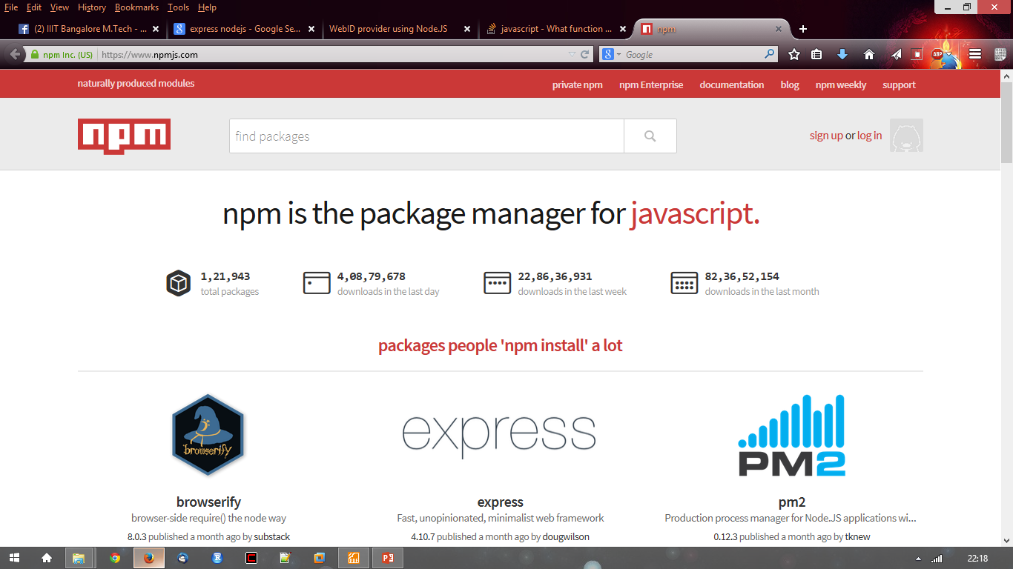
Node.js Modules….. MANY
● https://npmjs.org/
● # of modules = 1,21,943

Slide 21
Install a module…..inside your project directory
$npm install <module name>

Slide 22
Using module….. Inside your javascript code
var http = require(‘http’);
var fs = require(‘fs’);
var express = require(‘express’);

Slide 23
Hello World Example
STEP 1: create directory and call npm install and follow instructions
>mkdir myapp
>cd myapp
Use the npm init command to create a package.json file for your application. For more information, see Specifics of npm’s package.json handling.
> $ npm init
prompts you for a number of things, such as the name and version of your application. For now, you can simply hit RETURN to accept the defaults

Slide 24
Hello World example
Create file index.js with the following code:
http.createServer(function (request, response) {
// Send the HTTP header
// HTTP Status: 200 : OK
// Content Type: text/plain
response.writeHead(200, {'Content-Type': 'text/plain'});
// Send the response body as "Hello World“
response.end('Hello World\n'); }).listen(8081);
// Console will print the message
console.log('Server running at http://127.0.0.1:8081/');

Slide 25
Hello World example –package.json – describes application
{
    "name": "helloworld",
    "version": "1.0.0",
    "description": "simple hello world app",
    "main": "index.js",
    "scripts": {
    "test": "echo \"Error: no test specified\" && exit 1"
    },
    "author": "L. Grewe",
    "license": "ISC",
    "dependencies": {
    "express": "^4.14.1"
    }
}

Slide 26

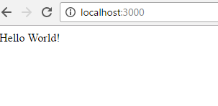
Run your hello world application
Run the app with the following command:
$ node app.js
Then, load http://localhost:3000/ in a browser to see the output.

Slide 27
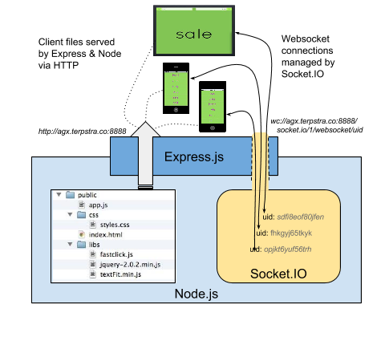
Express
minimal and flexible Node.js web application framework that provides a robust set of features for web and mobile applications.

Slide 28
Express gives ease of functionality
Routing
Delivery of Static Files
“Middleware” – some ease in development (functionality)
Form Processing
Simple forms of Authentication
Cookies and Session Manipulation
A lot of this you can do in NodeJS but, you may write more code to do it than
if you use the framework Express.
There are other alternatives than Express (the E in MEAN) like Sail, Meteor

Slide 29
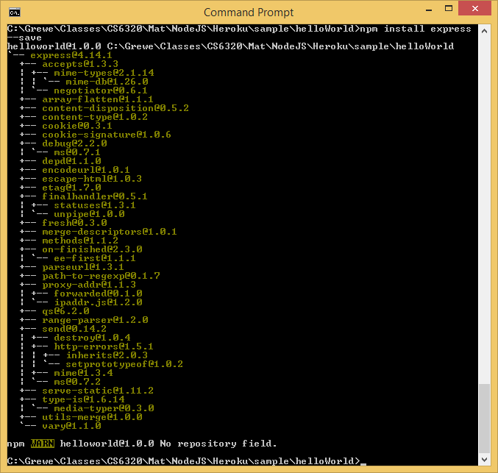
Install express
install Express (if you want it, most will)and any other dependencies needed
Now install Express in the myapp directory and save it in the dependencies list. For example:
>$ npm install express --save

Slide 30
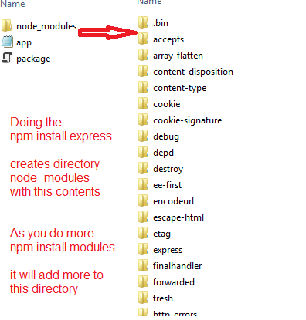
Express install
Will add files
to the node_modules
directory
If this is the first
module you
have installed for
current application
IT will create the
node_modules
directory first.

Slide 31
ALTERNATIVE to install - generator
npm install express-generator -g express helloapp
create : helloapp
create : helloapp/package.json
create : helloapp/app.js
create : helloapp/public
create : helloapp/public/images
create : helloapp/routes
create : helloapp/routes/index.js
create : helloapp/routes/users.js
create : helloapp/public/stylesheets
create : helloapp/public/stylesheets/style.css
create : helloapp/views create : helloapp/views/index.jade
create : helloapp/views/layout.jade
create : helloapp/views/error.jade
create : helloapp/bin
create : helloapp/bin/www
install dependencies:
$ cd helloapp && npm install
run the app:
$ DEBUG=helloapp:* npm start
create : helloapp/public/javascripts

Slide 32
Express – hello world code
index.js have the code
    var express = require('express')
    var app = express()
    app.get('/', function (req, res) {
    res.send('Hello World!')
    })
    app.listen(3000, function () {
    console.log('Example app listening on port 3000!')
    })
This says requires module express
Calls function express to initialize object app
App object has various methods like get
that responds to HTTP get request.
This code will be call the function specified when
a GET for the URI / is invoked
Sets up the HTTP server for listening port 3000

Slide 33
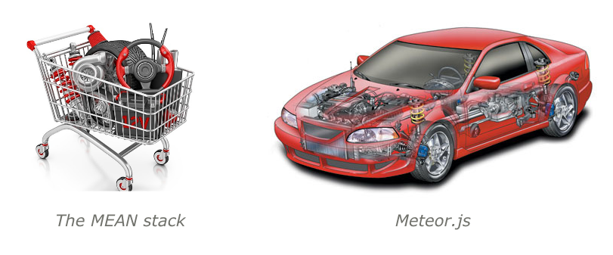
NEXT ------
Go over class website to see how to use MongoDB and more on Express!!!
Once you are done, you will understand the basics of MEAN (without the A)
and a start towards using NodeJS for web systems.
HOWEVER…..I might suggest next learning about Meteor – less callbacks, more
subscription model than using MEAN

